Slide 1
Week 3 In-Class
06 Structural

Slide 2
Quiz Recap
Roller and pin connection
Think of reaction force
Symmetric
Linear system
Superposition
Set the object of interest first
i.e., set your subsystem first
Apply equilibrium equations
Action and reaction force pairs
4N
P
C
4m
A
B
Roller
Single
smooth pin
Ground
Ground
3m
3m

Slide 3
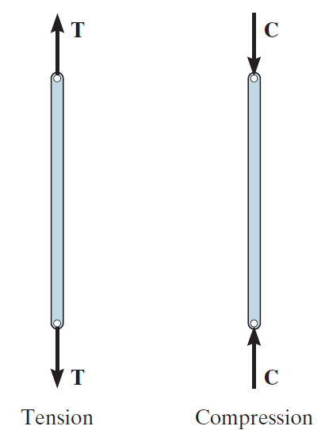
Tension and Compression
Sign of force vector on bar element
Sign of force vector on pin ?

Slide 4
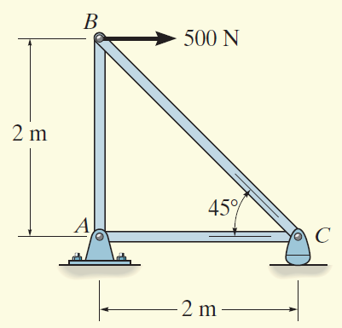
Method of Joints
Determine the force in each member of the truss and indicate whether the members are in tension or compression.

Slide 5
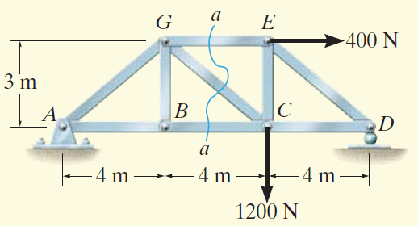
Method of Section
Determine the force in members GE, GC, and BC of the truss. Indicate whether the members are in tension or compression.

Slide 6
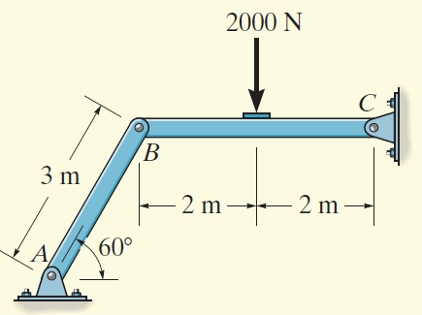
Two Force Member
Determine the horizontal and vertical components of force which the pin at C exerts on member BC of the frame
Think of reaction force vectors in pin A and pin C
It will simplify your calculation

Slide 7
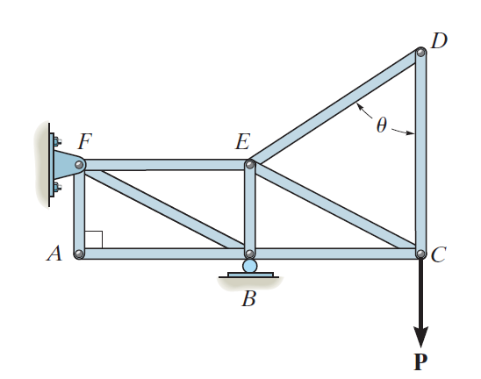
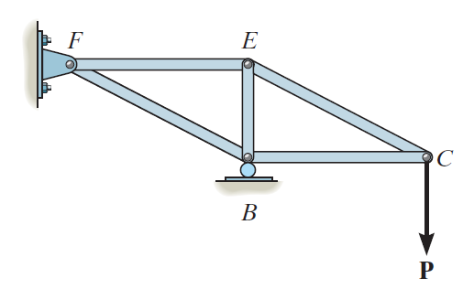
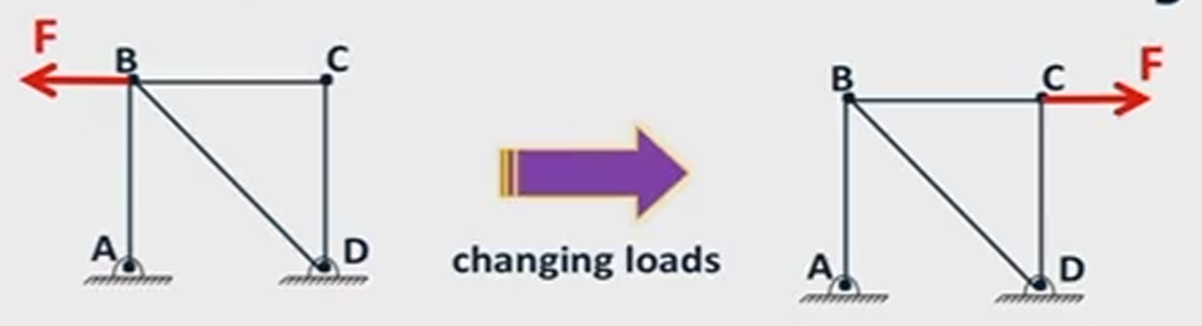
Zero-Force Members

Slide 8
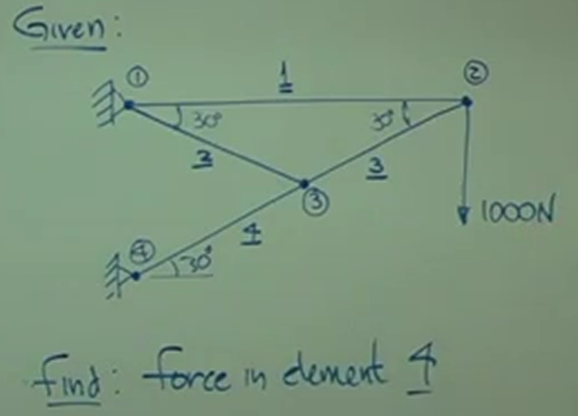
Excercise

